Slide 1
Compatibility between browsers and devices
Eleanor Robinson

Slide 2
1
What is compatibility?
2
Browser compatibility
3
Virtual Machines
4
Device compatibility
5
Chrome dev tools
6
Xcode simulators
7
Any questions?

Slide 3

The ability of machines or computer programs to work successfully with other machines or programs
Compatibility is…

Slide 4
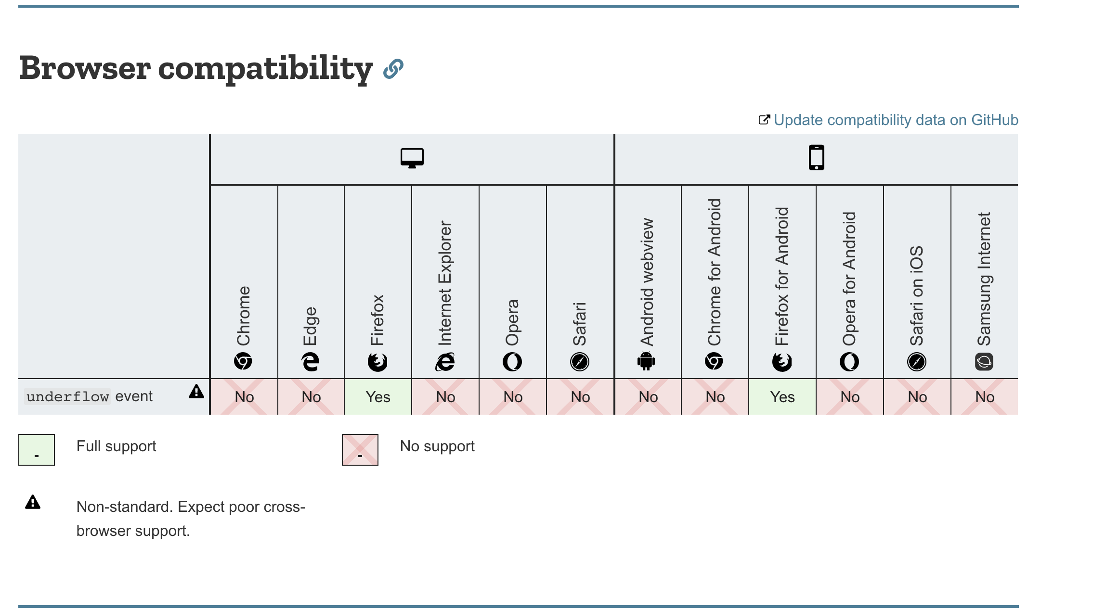

Slide 5
Browser compatibility
“When developers make use of new/nascent JavaScript features in their code, and find that such features don't work in older browsers” – MDN Web docs
https://developer.mozilla.org/en-US/docs/Web/API/Element

Slide 6
Polyfills
“A polyfill is a piece of code used to provide modern functionality on older browsers that do not natively support it” – MDN Web docs
https://github.com/zloirock/core-js

Slide 7
Virtual Machines
Needed to run Internet Explorer on a Mac
Free VMs available from Microsoft
https://developer.microsoft.com/en-us/microsoft-edge/tools/vms/
Use with VirtualBox
https://www.virtualbox.org/wiki/Downloads
Set up
https://medium.com/octopus-labs-london/4-ways-to-make-testing-ie-with-virtualbox-better-67f758ebb50e

Slide 8
How to ensure cross browser compatibility?
Check your work in different browsers
Ensure there is time in development for cross browser support
Know which browsers are a priority

Slide 9
Device compatibility

Slide 10
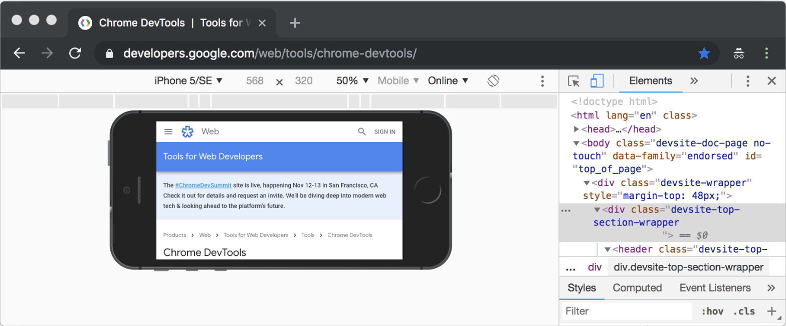
Chrome dev tools

Slide 11
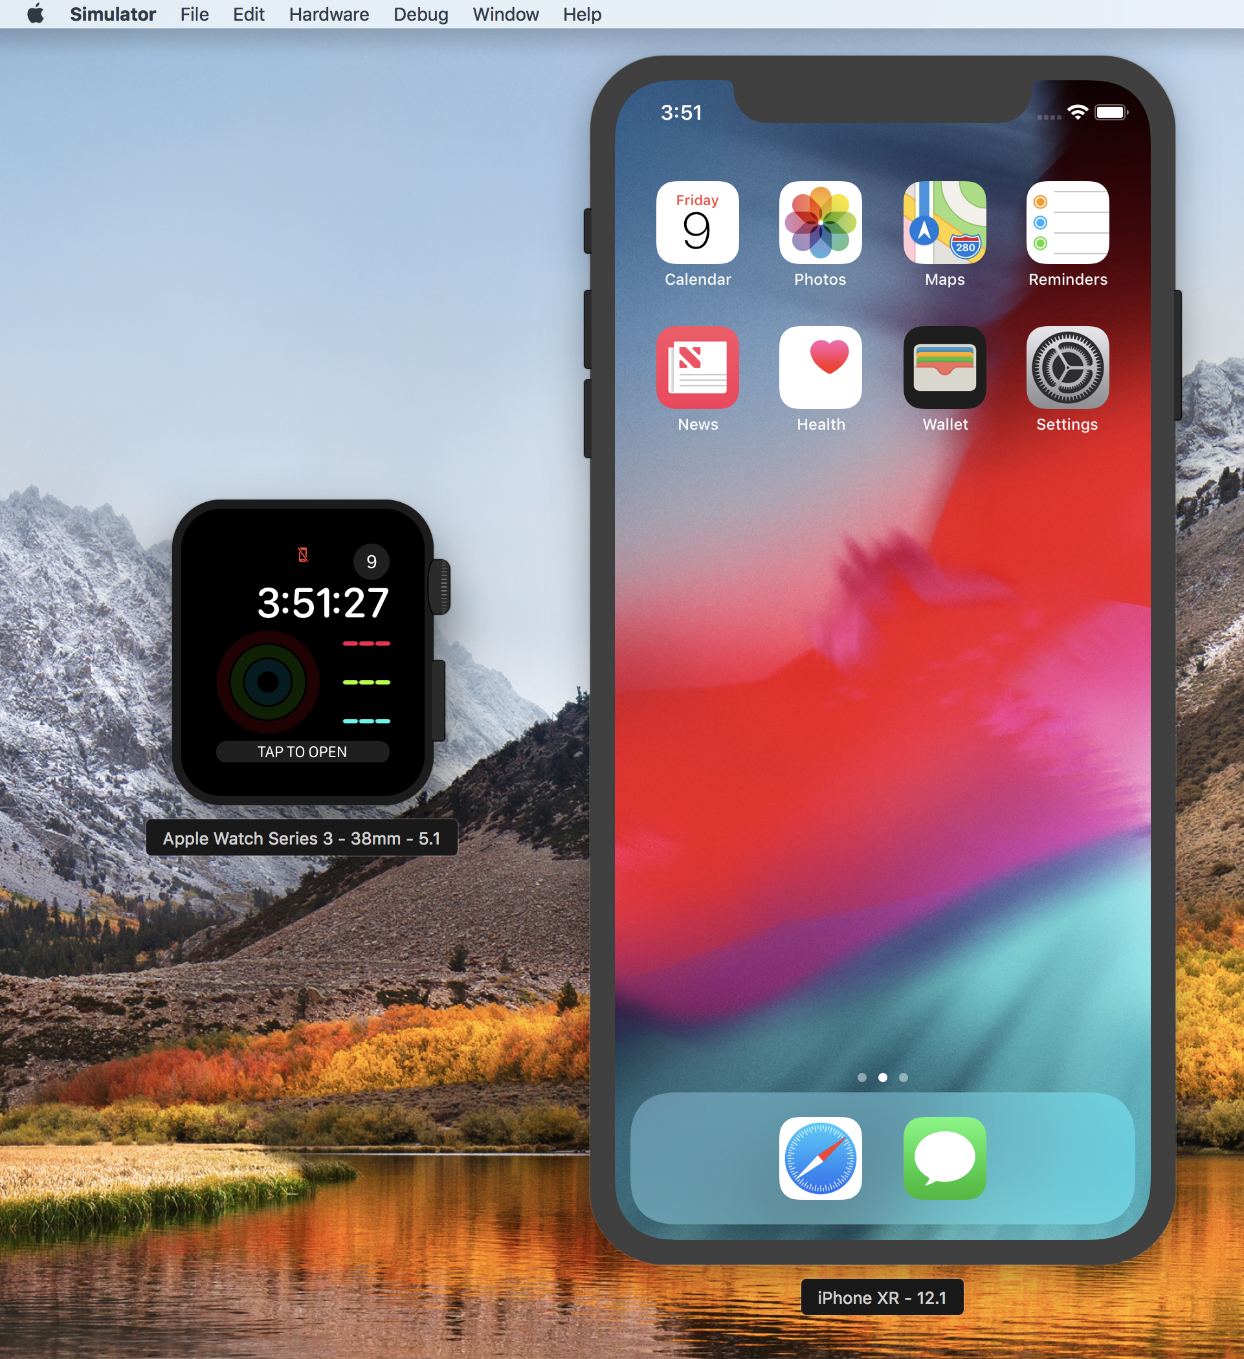
Xcode Simulators
Can inspect application on localhost in the simulator

